Slide 1
U08182: Information Systems Design
Prof. Hong Zhu
Department of Computing and Communication Technologies

Slide 2
Theme of the module
How to design information systems
Detailed design
Architectural design
Process and techniques to make new designs
Knowledge of software designs
OO design patterns
Software architectural styles
Evaluation of software designs
Quality of design
Testing, verification and validation of designs
Covered in other modules

Slide 3
Provisional Schedule
HZ: Hong Zhu
CC: Chris Cox
Week Lecturer Topic
1 HZ Principles of design methodology
2 HZ Software design methods and techniques
3 HZ Software design space
4 HZ Software architectural styles
5 HZ Software architectural Design
6 HZ Case Study/Coursework Briefing
7 CC Software design quality
8 CC Evaluation and analysis of software design
9 CC Validation and verification of software design
10 CC Testing software design
11 CC Consolidation / Revision

Slide 4
Assessment
Examination:
Weight: 50%
Format: 2 hours, answer 3 out of 4 questions
Case study will be announced in week 6
Unseen
Coursework:
Weight: 50%
Group work
5 students a group
Signup to a group on Moodle
Detailed specification of coursework will be posted on the website
Submission :
Deadline:1pm on Tuesday, Week 10 (1 April, 2014).
Late submissions will not be marked.
Must be uploaded to Moodle website
Each group submit one copy by the group leader

Slide 5
Textbook and Reading List
Main Textbook
*** Zhu, H., Software Design Methodology - From Principles to Architectural Styles, Elsevier Science, 2005.
Recommended Further Readings
** Software Design, 2nd Edt, David Budgen, Addison Wesley, 2003.
** Software Architecture: Perspectives on an Emerging Discipline, Mary Shaw, David Garlan, Prentice Hall, 1996.
** Software Architecture: Foundations, Theory, and Practice, Richard N. Taylor, Nenad Medvidovic, and Eric Dashofy. John Wiley & Sons. 2010.
** Software Architecture in Practice, Len Bass, Paul Clements, Rick Kazman, Addison Wesley, 1998.
** Software Design: From Programming to Architecture, E.J. Braude, John Wiley and Sons, 2003.
** Design Patterns Explained: A New Perspective on Object-Oriented Design, Alan Shalloway and James R. Trott, Addison Wesley, 2002.
* Software Architecture and Design: Principles, Models, and Methods, Bernard Witt, F. Terry Baker and Everett Merritt, Van Nostrand Reinhold, 1994.

Slide 6
Practical Classes
Tuesday 3:00 – 5:00
All Sets: C128
Note:
Answers to practical class exercise questions will NOT be posted on the Website
Attendance to practical classes will be recorded

Slide 7
Principles of Design Methodology
Lecture 1
Prof. Hong Zhu
School of Technology

Slide 8
Today’s Lecture
What is design?
Characteristics of design activities
Elements of designs
Factors that effect design processes and outcomes

Slide 9
What Is Design (I)
Dictionary of Contemporary English: (Longman,1987)
As a noun:
1. A drawing or pattern showing how something is to be made;
2. The art of making such drawings or patterns;
3. The arrangement of parts in any man-made product, such as a machine or work of art, as this influences the product's practical usefulness;
4. A decorative pattern, esp. one that is not repeated;
5. A plan in the mind.
As a verb:
1. To make a drawing or pattern of (something that will be made or built); develop and draw the plans for;
2. To plan or develop for a certain purpose or use.

Slide 10
What Is Design (II)
Quote from design methodologists:
“The optimum solution to the sum of the needs of a particular set of circumstances.”
(Matchett, E., 1968)
“The process of design is the same whether it deals with the design of a new oil refinery, the construction of a cathedral or the writing of Dante’s Divine Comedy.”
(Sydney Gregory, 1966)
“Design is to initiate change in man-made things.”
(Chris Jones 1970)

Slide 11
Research on Design Methodology
Emerged in 1960s as an independent scientific discipline
Studies the fundamental questions about design in the widest context
What are the essential characteristics of design?
What are design activities?
How design activities are interrelated to each other?
What processes are used by designers?
Is one process better than another, constituting 'right' and ‘wrong' ways to design?
Why are some processes favourable over others?
Do different processes lead to different qualities of results?

Slide 12
Two Facets of Designs
The product facet:
Design as noun
The outcome of design activities
The product -- plan of bringing about a man-made artifact
The process facet:
Design as verb
A sequence of activities
The process that a plan is made

Slide 13
The Process Facet
Transformation
Development
Creation
Discovery of constraints
Constraint satisfaction
A need or
a problem to be solved
+
Constraints on the solution
Scheme of implementation
Objectives
Description of product
Rationales
Plan of production
usage
Design Process
Diversity
Evolution
Problem solving
Decision making
Navigation in design space

Slide 14
Characteristics of Design Activities
Design starts with a need and requires intention
Design results in a scheme for implementing an artefact
Design involves transformation
Generation of new idea is fundamental to design
Design is problem solving and decision making
Design must satisfy constraints and discovers constraints
Design is to achieve optimality in a solution space of diversity
Design demonstrates an evolution process

Slide 15
The Product Facet: Elements of a Design
Statement of the objective(s)
Description of what is to be achieved by the designed product
Constraints on the design
Description of the constraints under which the designed product achieves the objective(s)
Description of the product
Description of the product to be produced
Plan of Production
Description of how the product is to be produced
Rationale of the design
Statements that justify why the designed product and its associated production plan can achieve the objectives and satisfy the constraints
Conditions of Usage
Description of the conditions under which the product should be used

Slide 16
Example of Design
Edison’s designs of electric lights

Slide 17
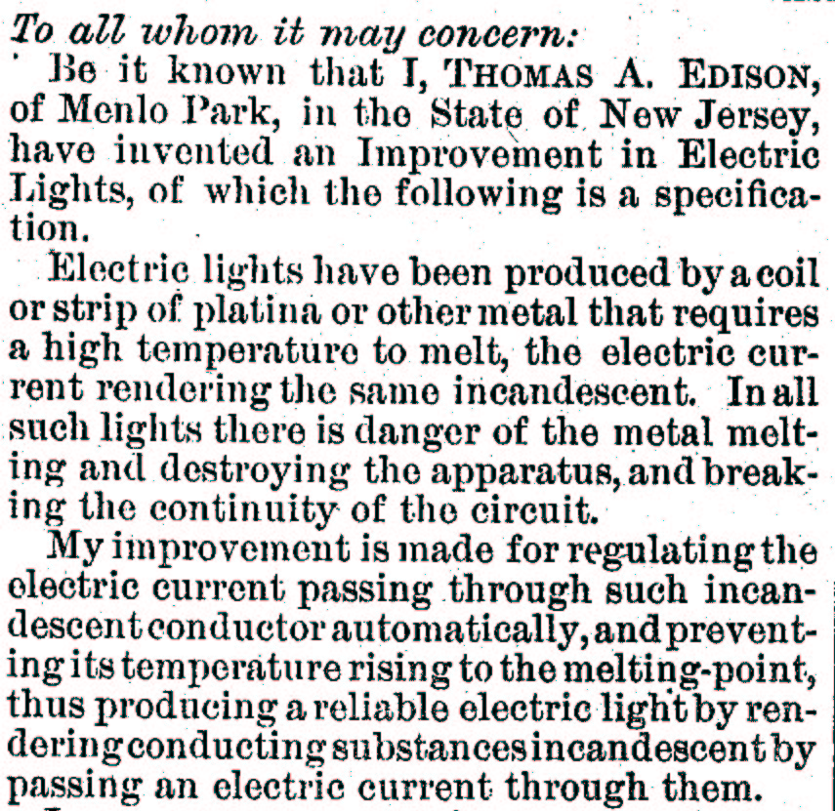
Objectives
A design may have a number of different objectives that must be satisfied as a whole
Design objectives is often expressed in a number of different levels of abstraction
Between different levels of objectives, there may have some assumptions

Slide 18
Constraints:
Lawson’s Theory about three dimensions of constraints
The generator of the constraints: (Who brings the constraint/design problem?)
users, clients, legislators, designers
The domain of the constraints: (What does the constraint influence?)
External: Constraints on the object and its external environment
Internal: Constraints on the internal structure and function of the object
The function of the constraints: (Why the constraint is imposed?)
Symbolism and social norms
Formal intentions of the designer
Practical implications brought by the implementation technologies
‘Radical' reasons that deal with the primary purpose of the artefact

Slide 19
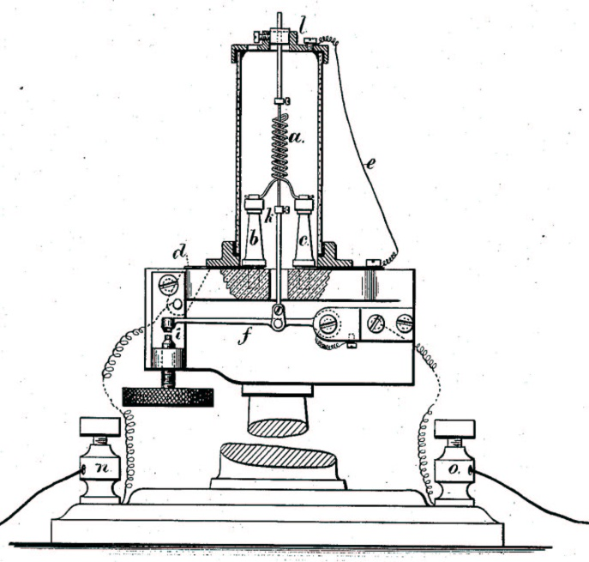
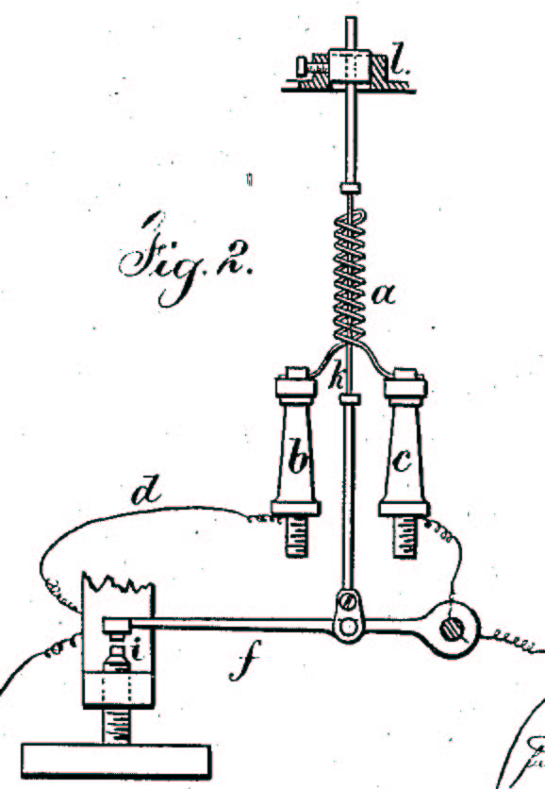
Descriptions of Designed Products
Multiple views:
Using different notations to describe different aspects of a design
Structural or hierarchical representation:
Representing a complicated design at a number of different abstraction levels and with different details

Slide 20
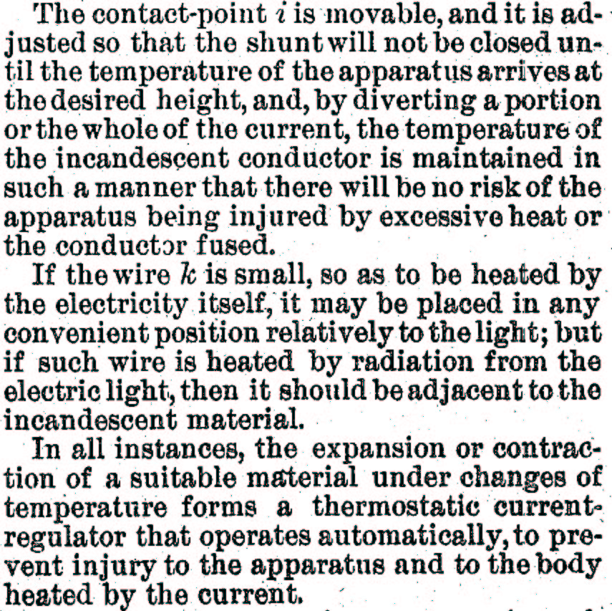
Rationales
Engineering design must be based on scientific principles and technical information.
A 'design space’: a body of knowledge about artefact, its environment, its intended use, and the decisions that went into creating the design.
A kind of meta-knowledge about how they arrived at a particular design.

Slide 21
Description of Production
The description of the production of a product can be as complicated as, even more complicated than the product.

Slide 22
Description of Usages

Slide 23
Definition
Engineering design is the use of scientific principles and technical information in the creative development of a plan to bring about a man-made product to achieve a prescribed goal with certain pre-specified constraints.

Slide 24
Factors That Affect Design
Mayall’s Axioms of Design
These axioms states the factors that affect the design process and it outcomes, and how these factors may interrelate to each other.
Axioms:
Self-evidence of their truth, sometimes sound trivial
They are basic, i.e. their truth cannot be proved from anything else
They are widely applicable to the domain

Slide 25
The Principle of Totality
Name of the axiom
Axiom 1:
All design requirements are always interrelated and must always be treated as such throughout a design task.
It identifies requirements as the key factor that affects design
It identifies the key property of this factor:
Requirements consists of many interrelated items
The set of items must treated by taking interrelation into account

Slide 26
The Principle of Time
Axiom 2:
The features and characteristics of all products change as time passes.
Each design has its own features and characteristics. They are what designers want to achieve.
However, the features and characteristics of a design is not constant. They change as time passes.
Question: What are the reasons for this?

Slide 27
The Principle of Value
Axiom 3:
The characteristics of all products have different relative values depending upon the different circumstances and times in which they may be used.
It identify the relationship between the value of a characteristic of a product and the uses of the product.
Value (the importance) of characteristics depends on the uses.

Slide 28
The Principle of Resources
Axiom 4:
The design, manufacture and life of all products and systems depend upon the materials, tools and skills upon which we can call.
It identifies another key factor that affect designs: the resources
The types of resources:
Material
Tools
Skills
The impact of this factor is:
Role: restriction on the space of possible solutions
Scale: whole life cycle of the product

Slide 29
The Principle of Synthesis
Axiom 5:
All features of a product must combine to satisfy all the characteristics we expect it to posses with an acceptable relative importance for as long as we wish, bearing in mind the resources available to make and use it.
It identifies the relationships between two main factors:
Requirements (the characteristics that we expect to posses
Features of the product
Features must meet requirements according to the relative importance , where ‘meet’ is restricted by the resources.

Slide 30
The Principle of Iteration
Axiom 6:
Design requires processes of evaluation that begin with the first intentions to explore the need for a product or system. These processes continue throughout all subsequent design and development stages to the user himself, whose reactions will often cause the iterative process to continue with a new product or system.
This is an axiom about the design activities and processes.
It emphasises the important of evaluation in design process.
It states why design process is, and should be, iterative.

Slide 31
The Principle of Change
Axiom 7:
Design is a process of change, an activity undertaken not only to meet changing circumstance, but also to bring about changes to those circumstances by the nature of the product it creates.
This axiom is about the nature of design: change
Design is to meet changes in the world;
Design brings about changes to the world.

Slide 32
The Principle of Relationships
Axiom 8:
Design work cannot be undertaken effectively without established working relationships with all those activities concerned with the conception, manufacture and marketing of products and, importantly, with the prospective user, together with all the services he may call upon to assist his judgement and protect his interests.
This axiom is about the context in which design is performed.

Slide 33
Context of Software Design
Requirements analysis
Operation and maintenance
Requirement definition
Validated system
Functional specification
Acceptance test and release
Functional specification
Verified system
Architectural design
System integration
Architectural design spec
Integrated software
Phase
Detailed design
Software integration
Product
Module design spec
Debugged modules
Link between phases
Consistency check
Implementation
The ‘V’ Model

Slide 34
Cumulative cost
Progress through steps
Evaluate alternatives, identify, resolve risks
Determine objectives, alternatives, constraints
Risk analysis
Risk analysis
Risk analysis
Prototype
3
Operational
Prototype
Risk analysis
Prototype
1
Prototype
2
Commitment partition
Requirements plan
Life-cycle plan
Simulations, models, benchmarks
Concept of operation
Software requirements
Software product design
Detailed design
Development plan
Requirements validation
Code
Unit test
Integration and test plan
Design validation and verification
Integration and test
Plan next phase
Acceptance test
The Spiral Model
Implementation
Develop, verify next-level product

Slide 35
The Principle of Competence
Axiom 10:
Design competence is the ability to create a synthesis of features that achieves all desired characteristics in terms of their required life and relative value, using available effective information about this synthesis to those who will turn it into products or systems.
It identifies another important factor of design: the designer
The key feature of a designer is competence.

Slide 36
The Principle of Service
Axiom 11:
Design must satisfy everybody, and not just those for whom its products are directly intended.
It identifies yet another important factor of design: responsibility
Role: restriction on the solution space
Scale: the whole society in which the product is used, beyond the product itself.

Slide 37
Nature of Design Problems
Design problems are regarded as ‘ill-structured’ and ‘wicked’ on all three aspects of design
Formulation of problem
Solution space
Ways to solve problem (i.e. ways from problem to solution)

Slide 38
Wicked Design Problem (1)
No definitive formulation of the problem
The initial goals are usually vague
Many constraints and criteria are unknown
The context of the problem is often complex and poorly understood.

Slide 39
Wicked Design Problem (2)
No definitive solution to the problem
Solutions are often not true or false, but good or bad
Often no objective criterion for the evaluation of a solution
Often no best solution, even criteria that can be used as a ‘stopping rule’

Slide 40
Wicked Design Problem (3)
No definitive way of solving the problem
Resolving a discrepancy or inconsistency may pose another problem in its turn
The formulation of a problem often depends on the way of solving it
Many assumptions and uncertainty can be exposed only by proposing solution concepts
Many constraints and criteria emerge as a result of evaluating solution proposals
Sub-solutions of the design sub-problems can be found to be inter-connected with each other in ways that form a pernicious circular structure to the problem

Slide 41
Major Causes of Difficulties in SD
Complexity. It is an essential property of software.
Conformity. Software is expected to conform to the standards imposed by other components, such as hardware, or by external bodies, or be existing software.
Changeability. Software suffers from constant needs of changes.
Invisibility. Any forms of representations that are used to describe software will lack any form of visual link that can provide an easily grasped relationship between the representation and the system.
Brooks, F. P. Jr,
No silver bullet: essence and accidents of software engineering,
IEEE Computer, 1987, pp10~19.

Slide 42
Common Design Errors
Incorrectness. The design does meet the users’ requirements on its functionality and features.
Inconsistency. Different parts or aspects of the design conflict with each other. Consequently, it does not work.
For example, if two design statements make conflicting assumptions about the functionality of a component or the meaning of a data item.
Ambiguity. The design specification may be interpreted in several different ways, or it is not clear enough.
Ambiguity causes errors in the implementation of the design due to inconsistent interpretations made in the implementation process.
Inferiority. The design does not address quality requirements adequately.
Typically inefficiency and inflexibility, etc. Inflexibility causes the designed software to be difficult to change.

Slide 43
Further Readings
[1] Zhu, H., Software Design Methodology - From Principles to Architectural Styles, Chapter 1 and 2.
[2] Bryan Lawson, How Designers Think – The Design Process Demystified, A completely Revised Third Edition, Architectural Press, Elsevier, 1997. Chapter 6, A model of design problems, pp62-112.
[3] Budgen, D, Software Design, Addison-Wesley, 1994. Chapter 1 and 4, pp1~23, 57~76.
[4] Cross, N., Engineering Design Methods: Strategies for Product Design, Third Edition, John Wiley and Sons, 2000. Part One: Understanding Design.

